Slide 1
Single-Page Applications
Overview of SPAs
Creating components
Angular routing
Demo app: AngularDev/Demos/02-SinglePageApps/DemoApp
To install: npm install
To run: ng serve

Slide 2
Section 1: Overview of SPAs
What is an SPA?
Demo application
Creating an application with routing

Slide 3

What is an SPA?
According to Wiki:
A single-page application is a web app that fits on a single web page with the goal of providing a more fluent user experience similar to a desktop application.
In an SPA, either all necessary code – HTML, JavaScript, and CSS – is retrieved with a single page load, or the appropriate resources are dynamically loaded and added to the page as necessary, usually in response to user actions. The page does not reload at any point in the process, nor does control transfer to another page.
Interaction with the SPA often involves dynamic communication with the web server behind the scenes.
3

Slide 4
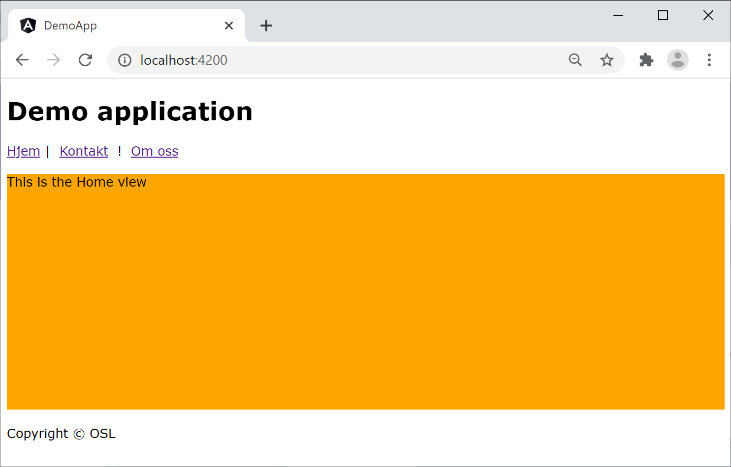
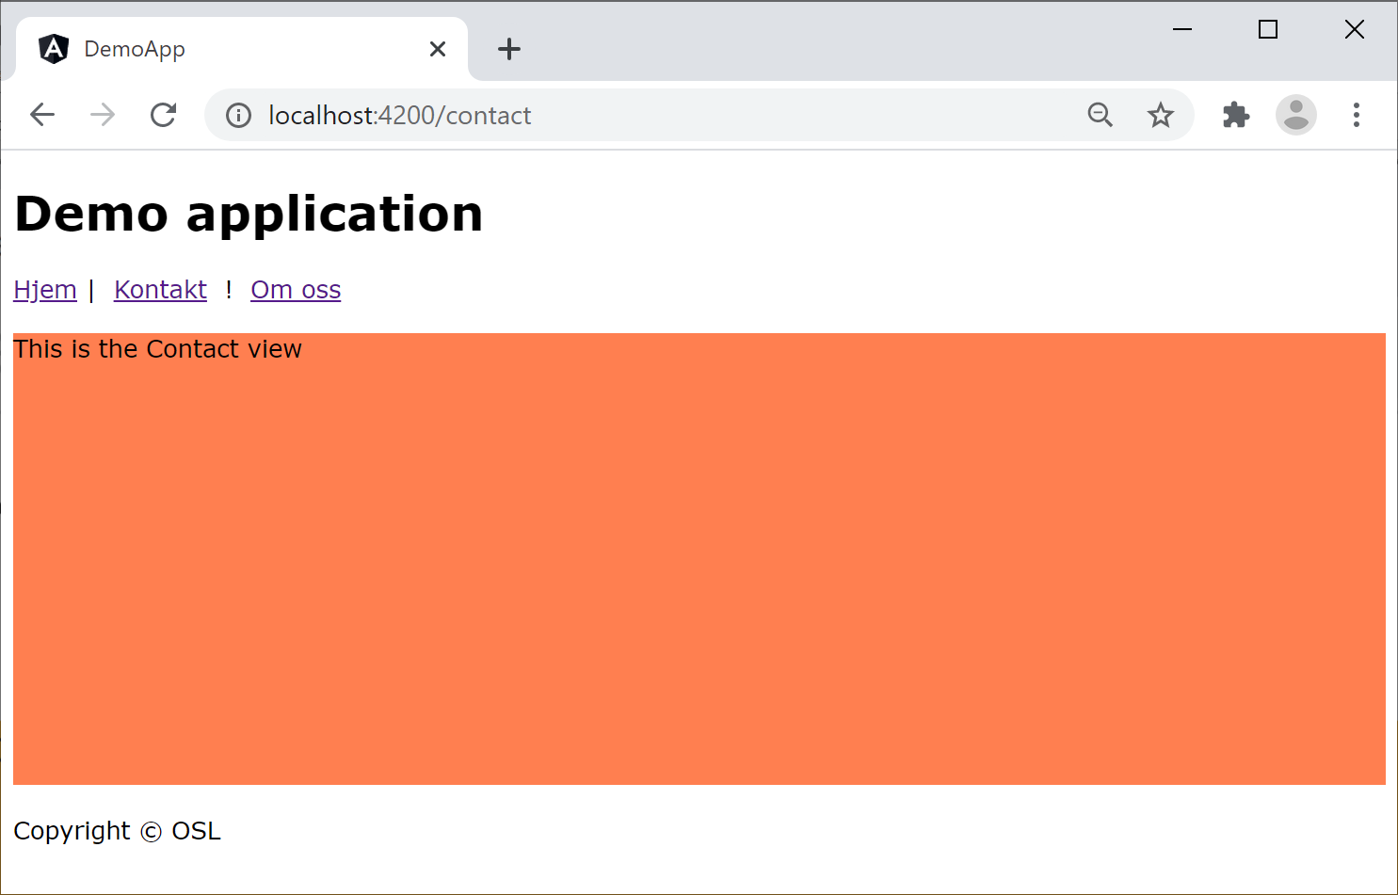
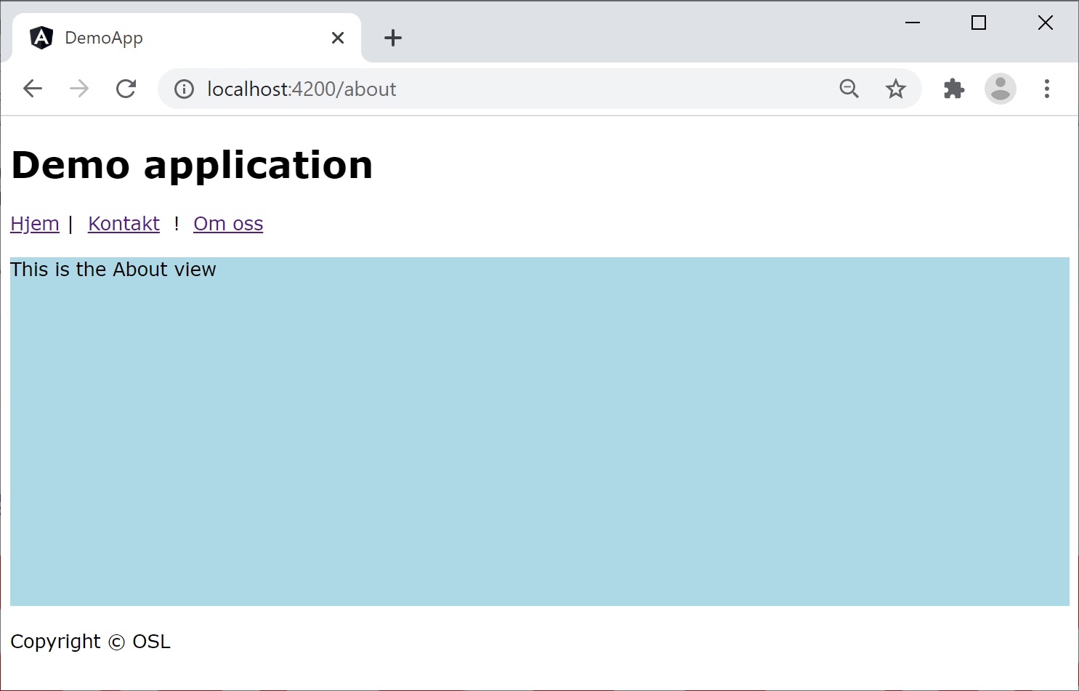
Demo Application (1 of 2)
Angular has good support for SPAs, see this demo:
02-SinglePageApps/DemoApp
/
/contact
/about
4

Slide 5
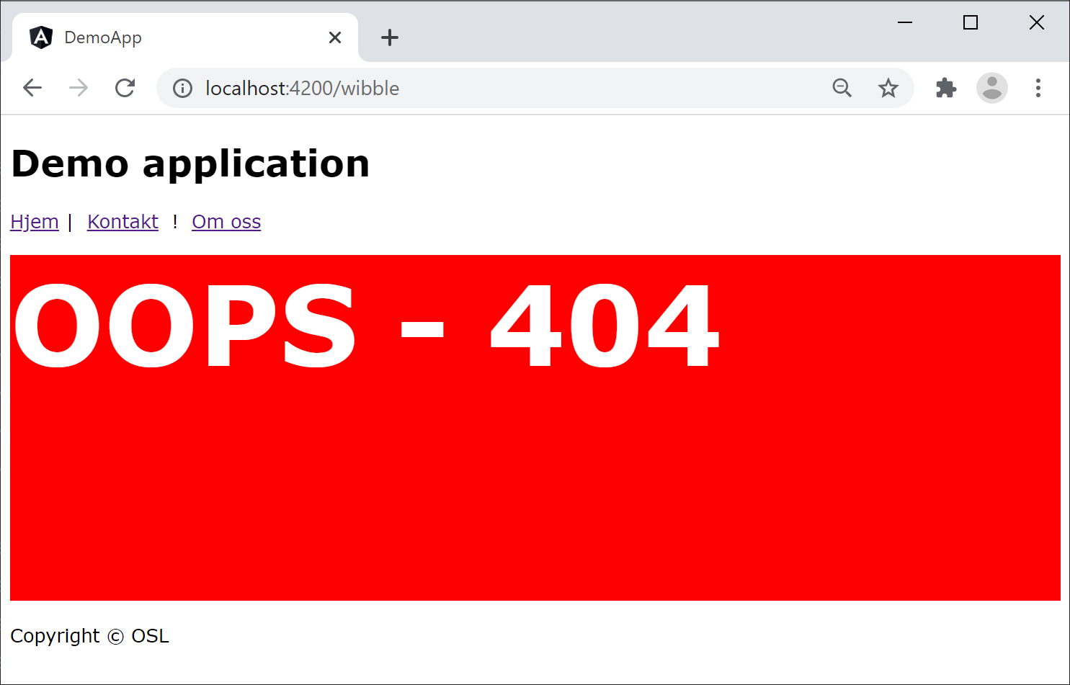
Demo Application (2 of 2)
The application also has a "page not found" component for unrecognised URLs
/wibble
5

Slide 6
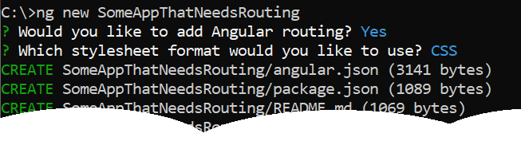
Creating an Application with Routing
If you're using Angular CLI to create your application…
Then you should answer "yes" when it asks if you'd like to add Angular routing to the app
We'll explain all about routing later in this chapter…
First we'll see how to create new components
6

Slide 7
Section 2: Creating Components
Overview
Creating artifacts using Angular CLI
How to create a component
Reviewing the component
Summarizing our application's components
Reviewing the module code
Aside: Defining global styles

Slide 8
Overview
An Angular application typically has many components:
A root component (typically named AppComponent)
Plus many additional components
Our demo application has 4 additional components:
HomeComponent
ContactComponent
AboutComponent
PagenotfoundComponent
8

Slide 9
Creating Artifacts using Angular CLI
You can use Angular CLI to create artifacts in your app
Type of artifact | How to generate using Angular CLI
Component | ng g component my-new-component
Directive | ng g directive my-new-directive
Pipe | ng g pipe my-new-pipe
Service | ng g service my-new-service
Class | ng g class my-new-class
Interface | ng g interface my-new-interface
Module | ng g module my-module
Web worker | ng g web-worker my-web-worker
9

Slide 10
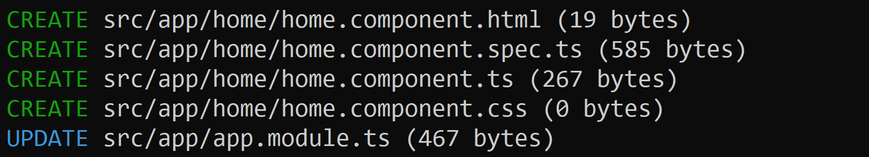
How to Create a Component
This is how we created the home component in our demo application, using Angular CLI
Angular CLI adheres to the Angular style guide:
https://angular.io/guide/styleguide
ng g component home
10

Slide 11
Reviewing the Component (1 of 3)
Angular CLI created a new folder for the component
src/app/home
Angular CLI created 4 files for the component, using a standardized file-naming convention:
home.component.ts
home.component.html
home.component.css
home.component.spec.ts
11

Slide 12
Reviewing the Component (2 of 3)
Here's the code in home.component.ts:
We'll discuss constructor() and ngOnInit() later
import { Component, OnInit } from '@angular/core';
@Component({
selector: 'app-home',
templateUrl: './home.component.html',
styleUrls: ['./home.component.css']
})
export class HomeComponent implements OnInit {
constructor() {}
ngOnInit(): void {}
}
src/app/home/home.component.ts
12

Slide 13
Reviewing the Component (3 of 3)
Here's our home.component.css:
We've defined simple styles for this component
div {
background-color: orange;
height: 300px;
margin: 20px 0px;
}
src/app/home/home.component.css
13

Slide 14
Summarizing our Application's Components
Here's a summary of the components we generated in our app via Angular CLI:
ng g component home
See src/app/home/
ng g component contact
See src/app/contact/
ng g component about
See src/app/about/
ng g component pagenotfound
See src/app/pagenotfound/
14

Slide 15
Reviewing the Module Code
When you create components using Angular CLI, it updates your module to incorporate the components:
import {HomeComponent} from './home/home.component';
import {ContactComponent} from './contact/contact.component';
import {AboutComponent} from './about/about.component';
import {PagenotfoundComponent} from './pagenotfound/pagenotfound.component';
…
@NgModule({
declarations: [
AppComponent,
HomeComponent, ContactComponent, AboutComponent, PagenotfoundComponent
],
…
})
export class AppModule { }
src/app/app.module.ts
15

Slide 16
Aside: Defining Global Styles
If you want to define global styles that apply across the entire website, define them here:
src/styles.css
Note: The location of global stylesheets is defined in angular.json, via the following property:
projects.XXX.architect.build.options.styles
body {
font-family: Verdana, Geneva, Tahoma, sans-serif;
}
src/styles.css
16

Slide 17
Section 3: Angular Routing
Angular routing dependencies
Defining a routing table
Defining a base href
Defining a router outlet
Defining router links
Running the application

Slide 18
Angular Routing Dependencies
If you want your Angular app to support routing, you must have this dependency in package.json:
Note:
Angular CLI adds this dependency automatically, if you select the "add routing" option
{
"dependencies": {
"@angular/router": "^14.1.0",
…
},
…
}
package.json
18

Slide 19
Defining a Routing Table (1 of 2)
You must define a routing table for your application
Maps relative URLs to components in your app
When the user navigates to one of these URLs:
Angular creates an instance of the relevant component, and renders it in a router outlet (see later)
Relative URL | Map the relative URL to this component…
(none) | HomeComponent
contact | ContactComponent
about | AboutComponent
(anything else) | PagenotfoundComponent
19

Slide 20
Defining a Routing Table (2 of 2)
Here's the routing table for our application:
import { NgModule } from '@angular/core';
import { Routes, RouterModule } from '@angular/router';
import { HomeComponent } from './home/home.component'
import { AboutComponent } from './about/about.component'
import { ContactComponent } from './contact/contact.component'
import { PagenotfoundComponent } from './pagenotfound/pagenotfound.component'
const routes: Routes = [
{ path: '', component: HomeComponent },
{ path: 'contact', component: ContactComponent },
{ path: 'about', component: AboutComponent },
{ path: '**', component: PagenotfoundComponent }
];
@NgModule({
imports: [RouterModule.forRoot(routes)],
exports: [RouterModule]
})
export class AppRoutingModule { }
src/app/app-routing.module.ts
20

Slide 21
Defining a Base href
You must also define a base href for your application
All router URLs are considered relative to this base href
You define the base href as follows in index.html:
<!doctype html>
<html lang="en">
<head>
<base href="/">
…
</head>
<body>
<app-root></app-root>
</body>
</html>
src/index.html
21

Slide 22
Defining a Router Outlet
Somewhere in your UI (typically the root component), define a <router-outlet> where components appear
Angular will display the appropriate component in the router outlet, depending on the current URL
SOME STUFF ALWAYS RENDERED HERE …
<router-outlet></router-outlet>
SOME MORE STUFF ALWAYS RENDERED HERE …
src/app/app.component.html
22

Slide 23
Defining Router Links
You can define router links in your web pages, to help the user navigate between components
Router links refer to routes in the routing table, prefixed by the base href
<h1>Demo application</h1>
<nav>
<a routerLink="/">Hjem</a>&nbsp;|&nbsp;
<a routerLink="/contact">Kontakt</a> &nbsp;|&nbsp;
<a routerLink="/about">Om oss</a>
</nav>
<router-outlet></router-outlet>
<p>Copyright &copy; OSL</p>
src/app/app.component.html
23

Slide 24
Running the Application
Here's a reminder of how the application looks
/
/contact
/about
24

Slide 25
Summary
Overview of SPAs
Creating components
Angular routing

